Slide 1


A Nurse-Managed Health Care Home Model of Integrated Care
UIC College of Nursing & Thresholds
Emily Brigell, MSN, BSN
Director Nurse-Managed Clinics
UIC College of Nursing
Sheila O’Neill
Vice-President, Clinical Practices
Thresholds

Slide 2
Objectives
  Describe an academic and community partnership model of integrated primary and mental health services
  Describe data utilization and outcome data
  Identify current challenges and strategies for addressing the changing health care environment

Slide 3
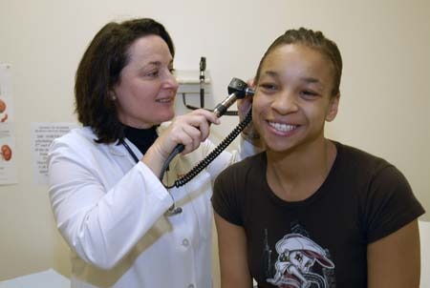
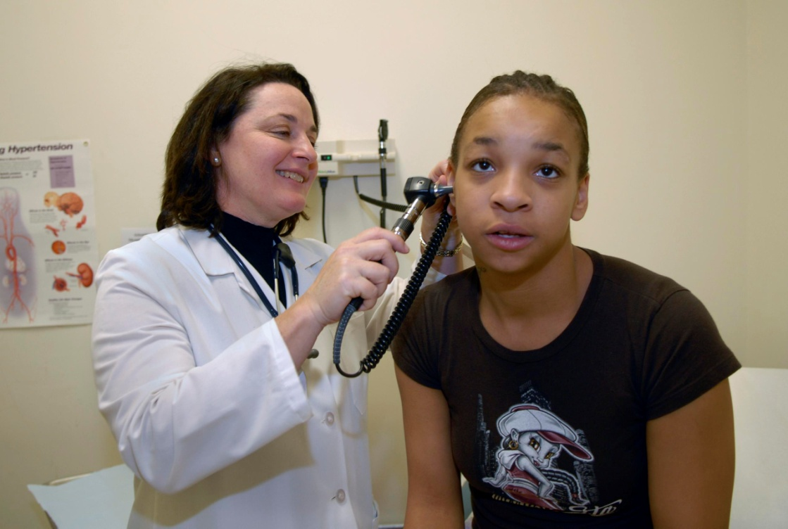
Integrated Health Care (IHC)
Primary and Mental Health Care for individuals with Severe Mental Illness (SMI)
16th year (1998 to present)--History
Part of Mile Square FQHC since July 2007
3 Clinics
Community Partner:
Thresholds Psychiatric
Rehabilitation Center

Slide 4
Key Components of the Model
Partners have synergistic mission and values
Primary care clinics are embedded within mental health agency service locations
Patient centered holistic care delivery
Ongoing collaboration and open communication between partners
  All clients receive support from Thresholds and care management from IHC
Evidence-based interventions
Data driven decision making (QI/PI)

Slide 5
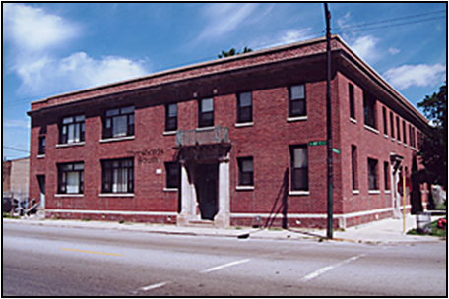
Threshold South IHC Clinic
734 West 47th
First Clinic – 1998
Primary & Mental Health Care
Added Psychiatric clinic 2012
Physical expansion 2014

Slide 6
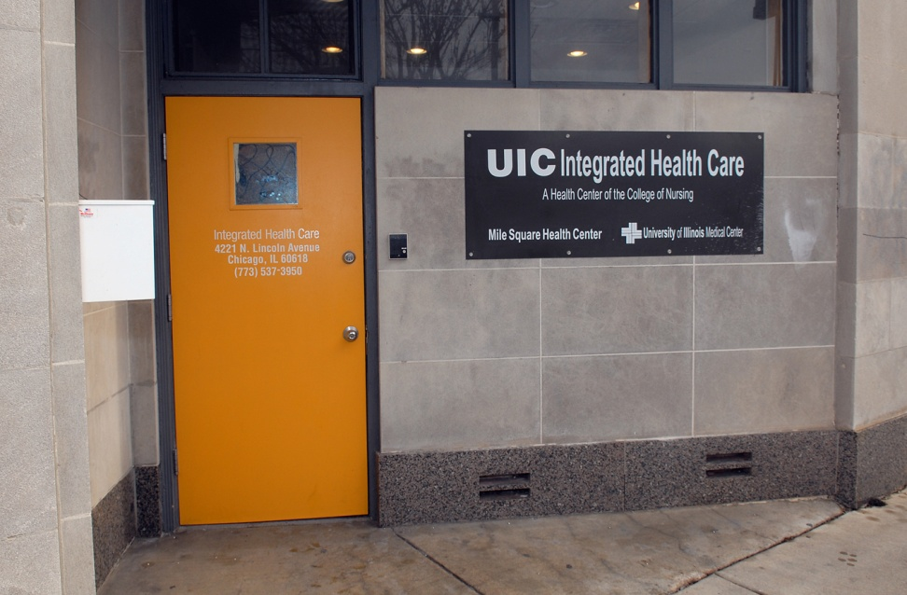
Thresholds IHC-North Clinic
4221 North Lincoln
Started in 2000
Young Adult building
Smallest location

Slide 7
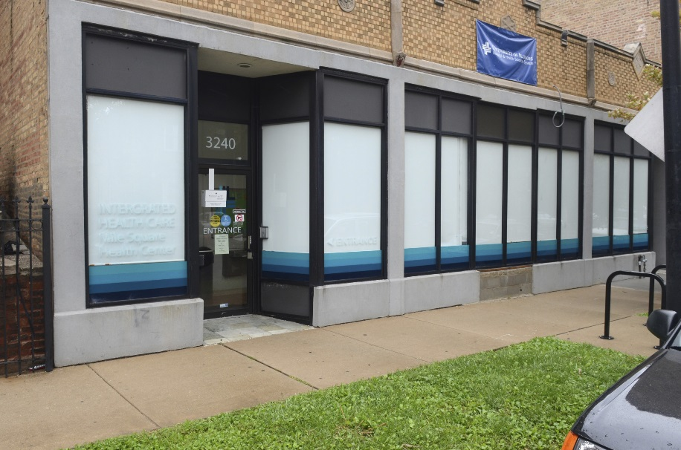
West Clinic
3240 W. Division, Humboldt Park
Opened April 2014
Additional focus on persons with physical disabilities
Anchor site for Community Care Alliance of Illinois

Slide 8
Growth in the Program
Notes:
Blue is psych-driving our growth

Slide 9
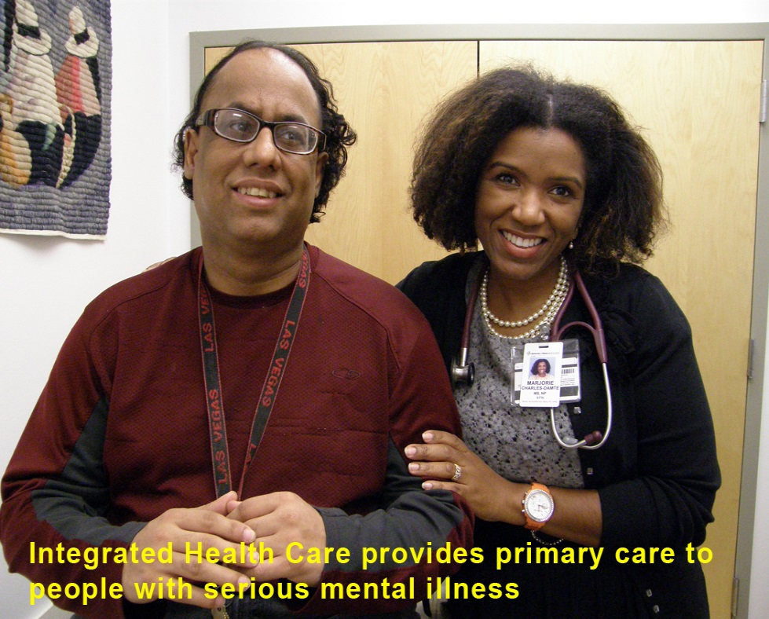
2014 Data
1511 patients
Over 9000 visits
Overall-3.7 visits/pt
IHC South
  Primary care-4.2 visits/pt
  Psych-7.2 visits/pt
No Show rates
  27% FY12 and FY13
  23.8% FY14

Slide 10
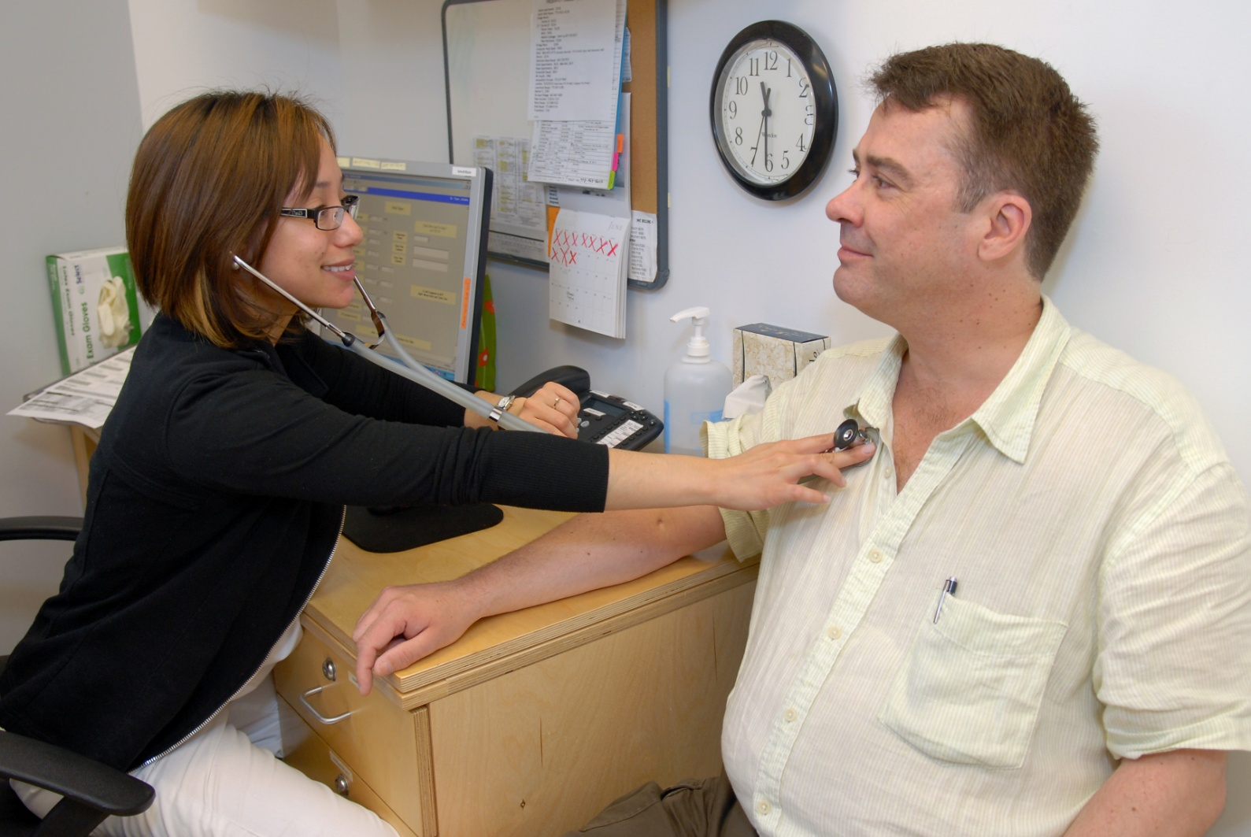
IHC Recognitions & Awards
2012 – American Academy of Nursing - Edge Runner designation
2011 - Illinois Health Connect - Your Healthcare Plus Top Performer “Excellence in Diabetes Management Award”
2009 - WHO Compendium of Primary Care Case Studies
2008 - AHRQ Innovation Exchange
2004 - Exemplar model of integrated primary and mental health service by the Bazelton Center for Mental Health Law
2003 - Outstanding Faculty Practice Award from the National Organization of Nurse Practitioner Faculties
2001 - Innovation in Health Care Access Award from the Illinois
Nurses Association

Slide 11
2014 Outcomes-data
Patient satisfaction:
  100% rate overall quality of care as good
  100% would recommend clinic
Diabetes:
  63-65% of patients with A1c less than 7
    Benchmark >58.9% Healthy People 2020
  12-14% with A1c>9
    Benchmark <16.1% Healthy People 2020

Slide 12
Outcomes-Continued
Hypertension
  81%-85% with blood pressure less than 140/90 on last visit
    Benchmark >61% Healthy People 2000
Obesity
  25% Patients with BMI > 30 who lost 3% of body weight in last 12 months

Slide 13

Thresholds has more than 55 years of experience in evidence-based community mental health services. We improve health outcomes and save money.
Thresholds has challenged and changed psychiatric rehabilitation practices, believing and demonstrating that with the proper supports and treatment, persons with mental illness can begin a recovery that will lead to a more fulfilling life.
The agency is an internationally-recognized model of mental health care, and e are expanding our service with even more integrated healthcare. More than 40 agencies worldwide have based their programming on the Thresholds model.
CREDENTIALS
    Fully CARF Accredited
    Licensed Community Mental Health Center
    Award-Winning Programs

Slide 14

Established
Comprehensive Approach: Housing, Employment, Recovery
Served annually
Million budget
Staff
Services Delivered in Community
Units of Housing Managed by Thresholds
1959
6700+
$65
1100+
70%
1500
Serving Chicago Metro area, Kankakee, and McHenry Counties

Slide 15
THRESHOLDS MEMBERS AT TIME OF ENTRY
50%
100%
90%
50%
*Avg. Income $9,869
87%
49%
87%
Notes:
At time of entry, Thresholds members
100% disabled
90% unemployed, average income $9,869
49% justice system
87% high school education or less

Slide 16
THRESHOLDS SERVICES
All clients that Thresholds serves have access to the following:
Assertive Community Treatment (ACT)
Community Support Team (CST)
Community Support Individuals (CSI)
Housing
HEDIS Compliance Assistance
Supported Employment
HIV Testing
Supported Education
Integrated Healthcare
Psychiatric Services
In addition, we have tailored programming for specific populations:
Veterans
Young Mothers
Young Adults (16-21)
Emerging Adults (18-28)
Persons who are Homeless
Deaf/Hearing-Impaired
Commercial Insurance and Private Payers

Slide 17
Success of the IHC Thresholds Relationship
Good relationships mean you spend time together = meetings
Access to each others’ Electronic Health Record (EHR)
Recently began entering IHC notes into Thresholds EHR
Major remodeling of a Thresholds location to improve the space for the clinic
Outreach to bring people to their appointments
Resources commitment from both partners
Better clinical outcomes
Health and Wellness Initiative with Peggy Swarbrick
Stop smoking focus

Slide 18
Challenges/Opportunities
No show rates inherent in population focus
Transition to Medicaid Managed Care
Gap between UI Health and Thresholds plans
Insurance plan restrictions in Nurse Practitioner panels
Cost of data-sharing and effort to integrate records

Slide 19
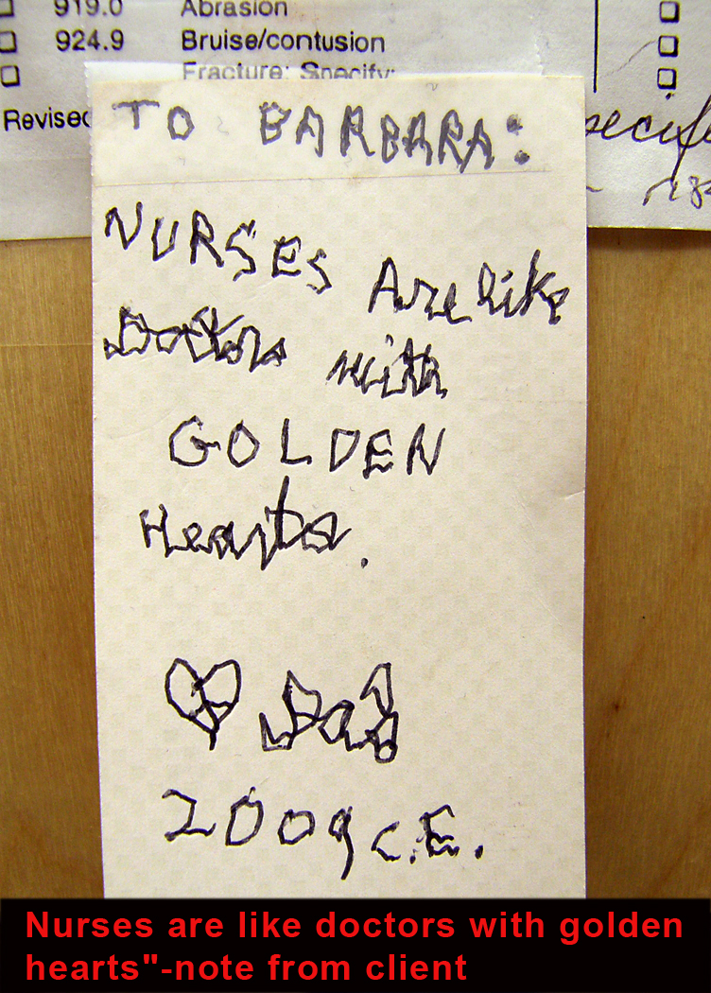
Client
Feedback
Why
Nurse-
Managed
Clinics?

